Slide 1

Pneumonia Detection using Chest X-Rays
Teammates
Sameera Rompicherla (SR23BA)
Yashwanth Gowram (YG23G)
Srirama Murthy Chellu (SC23BK)
Date: 5/2/2024
Course: DataScience Meets HealthScience

Slide 2
Overview
Description
There are 5,863 X-Ray images (JPEG) and 2 categories (Pneumonia/Normal). The dataset is organized into 3 folders (train, test, val) and contains subfolders for each image category (Pneumonia/Normal).
Chest X-ray images (anterior-posterior) were selected from retrospective cohorts of pediatric patients of one to five years old from Guangzhou Women and Children’s Medical Center, Guangzhou. All chest X-ray imaging was performed as part of patients’ routine clinical care.
Significance
Detecting pneumonia early is crucial because it allows doctors to start treatment right away. If it's not caught early, pneumonia can cause serious breathing problems and even lead to hospitalization or life-threatening complications like sepsis. So, finding it quickly is really important for helping people get better faster and avoiding more serious health issues.

Slide 3
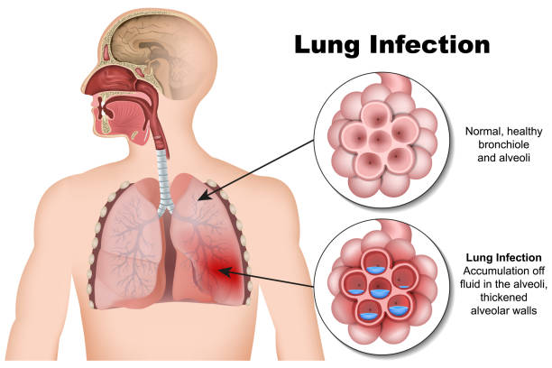

Introduction
Background Information
Pneumonia, a prevalent respiratory infection affecting the bronchi, alveoli, and interstitial lungs, poses significant health risks worldwide. Its etiology primarily includes viral and bacterial pathogens, leading to inflammation and fluid accumulation in the lungs. Diagnosis of pneumonia often involves medical imaging techniques, with chest X-rays being a frontline modality due to their wide availability and cost-effectiveness.

Slide 4
Relevance to field
Accurate and timely diagnosis of pneumonia is paramount for effective patient management and treatment planning. By leveraging artificial intelligence (AI) and machine learning (ML) techniques, we can enhance the efficiency and accuracy of pneumonia diagnosis from chest X-ray images. This not only improves patient outcomes but also streamlines healthcare workflows, reducing the burden on healthcare professionals and enhancing overall healthcare delivery. Moreover, advancements in pneumonia detection can pave the way for broader applications in medical imaging, driving innovation and progress in the field

Slide 5

Literature Review
Previous Work:
Previous studies on pneumonia detection using X-rays have explored various approaches. Some have focused on traditional image processing techniques, while others have utilized deep learning algorithms for automated detection. For example, researchers have applied convolutional neural networks (CNNs) to analyze X-ray images and identify patterns indicative of pneumonia. These studies have laid the groundwork for automated pneumonia detection systems that can assist radiologists in diagnosing cases more efficiently.
Limitations of Existing Approaches:
Despite advancements, existing approaches to pneumonia detection using X-rays still have limitations. Traditional image processing methods may lack the accuracy and robustness needed to handle variations in X-ray images, such as differences in positioning or quality. Similarly, early deep learning models may struggle with small or subtle pneumonia manifestations, leading to false negatives or positives. Additionally, the interpretability of some deep learning models remains a challenge, raising concerns about their reliability in clinical settings. Overall, while progress has been made, there is room for improvement in terms of accuracy, generalizability, and interpretability in automated pneumonia detection systems using X-rays.

Slide 6
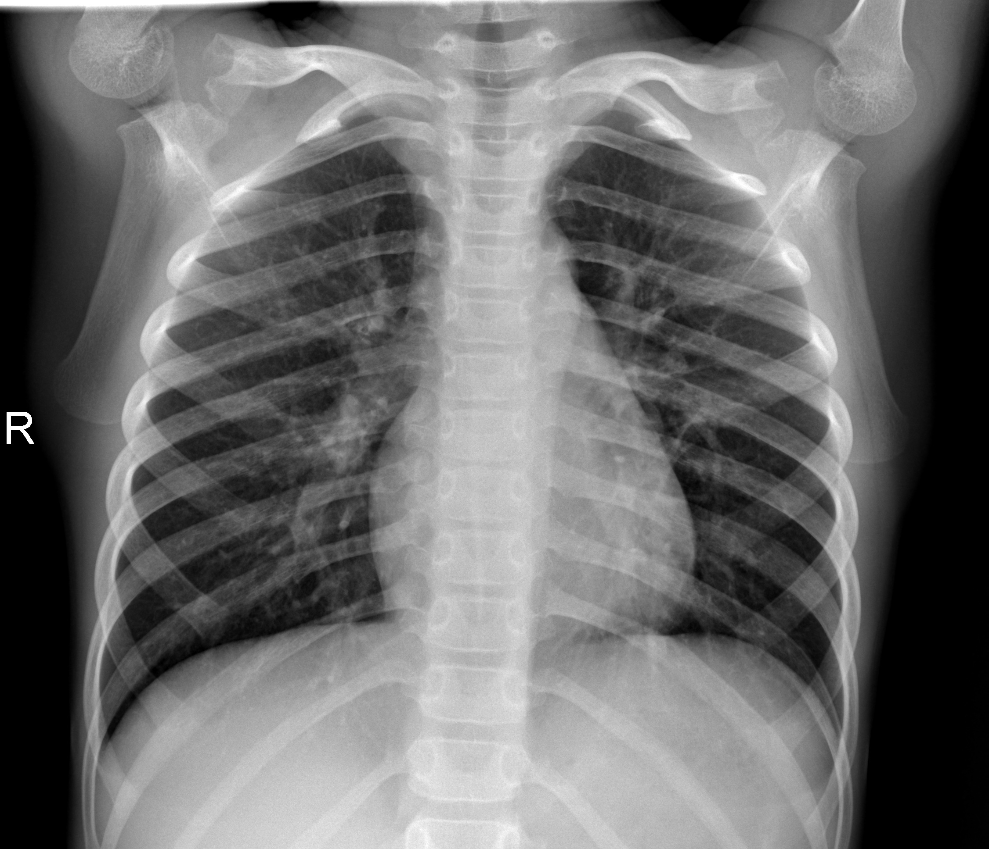
Project Flow
Load the data
Visualize the data
Preparing Data loaders
Build and train a model
Model Improvements:
Image Cropping
Data Augmentation
Fine tune the model
Accuracy Calculation and Graph Plotting
Predict and evaluate the results

Slide 7

Dataset collection
1. Dataset Organization
Folders: Train, Test, Validation
Subfolders: Normal (healthy), Pneumonia (diseased)
2. Dataset Distribution
Training Data: 5,160 images
Validation Data: 72 images
Testing Data: 624 images

Slide 8
Normal Chest X-Ray
Visual Features:
The lungs look clear with thin lines like branches in the background.
The edges of the lungs are clear and sharp.
There are no cloudy spots or other strange shapes.
Clinical Implications:
A normal chest X-ray indicates healthy lung function and the absence of acute pulmonary conditions. It serves as a baseline for comparison when evaluating chest X-ray images for abnormalities such as pneumonia

Slide 9
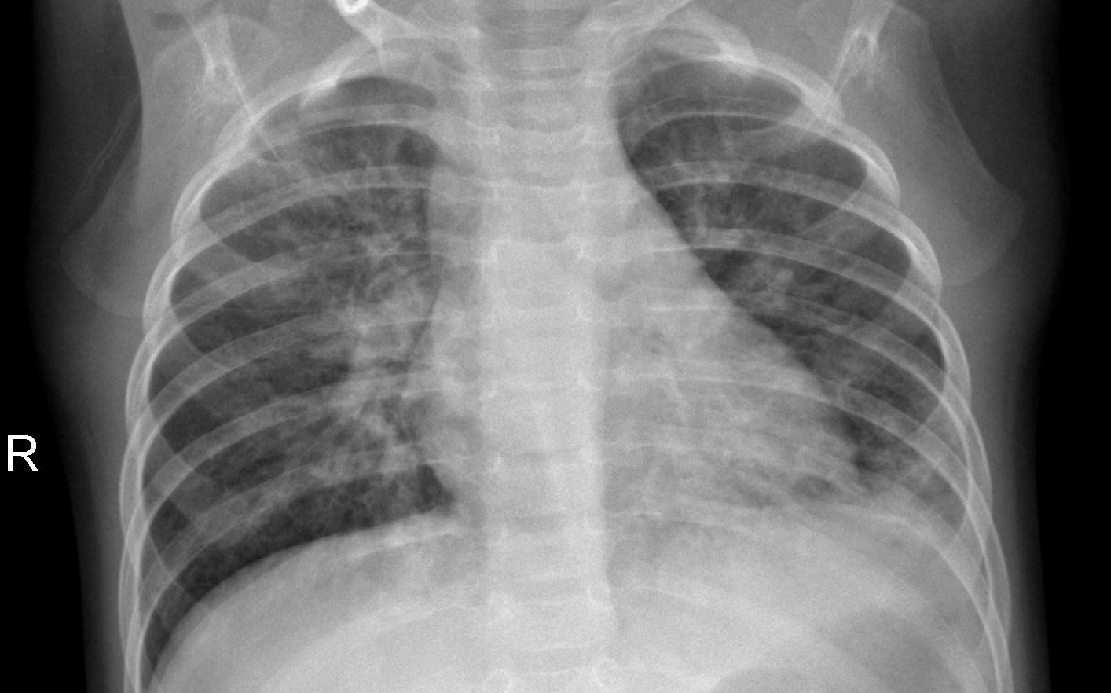
Pneumonia Chest X-Ray
Visual Features:
There are cloudy spots or patches in the lungs.
The edges of the lungs may not be clear because of the clouds.
Sometimes, there might be a blurry area around the lungs.
Clinical Implications:
Pneumonia is a common lung infection characterized by inflammation of the air sacs in one or both lungs, leading to symptoms such as fever, cough, and difficulty breathing. Timely diagnosis and appropriate treatment are essential for managing pneumonia effectively and preventing complications.

Slide 10
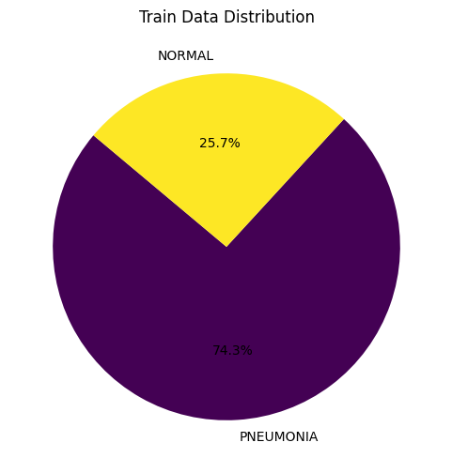
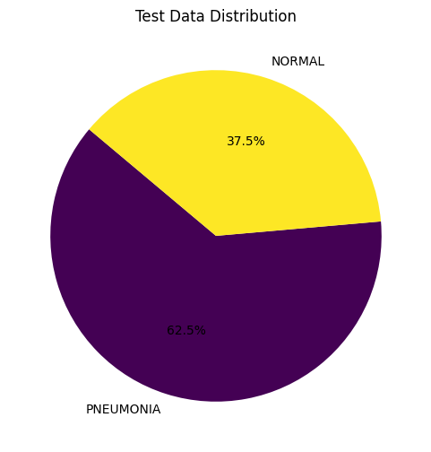
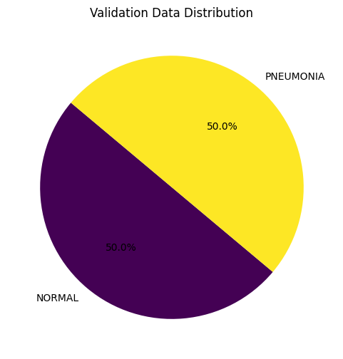
Visualizing Data on pie charts

Slide 11
Transformations
Horizontal Flip: Randomly flips the image horizontally to augment data and improve generalization.
Grayscale Conversion: Converts images to grayscale, setting the output to the specified number of channels.
Resize: Adjusts images to a uniform size for consistent processing(224 x 224)
Data Type Conversion: Converts image data to floating-point type for computation.
Normalization: Scales pixel values to a standard range to stabilize learning adjusted grayscale images

Slide 12
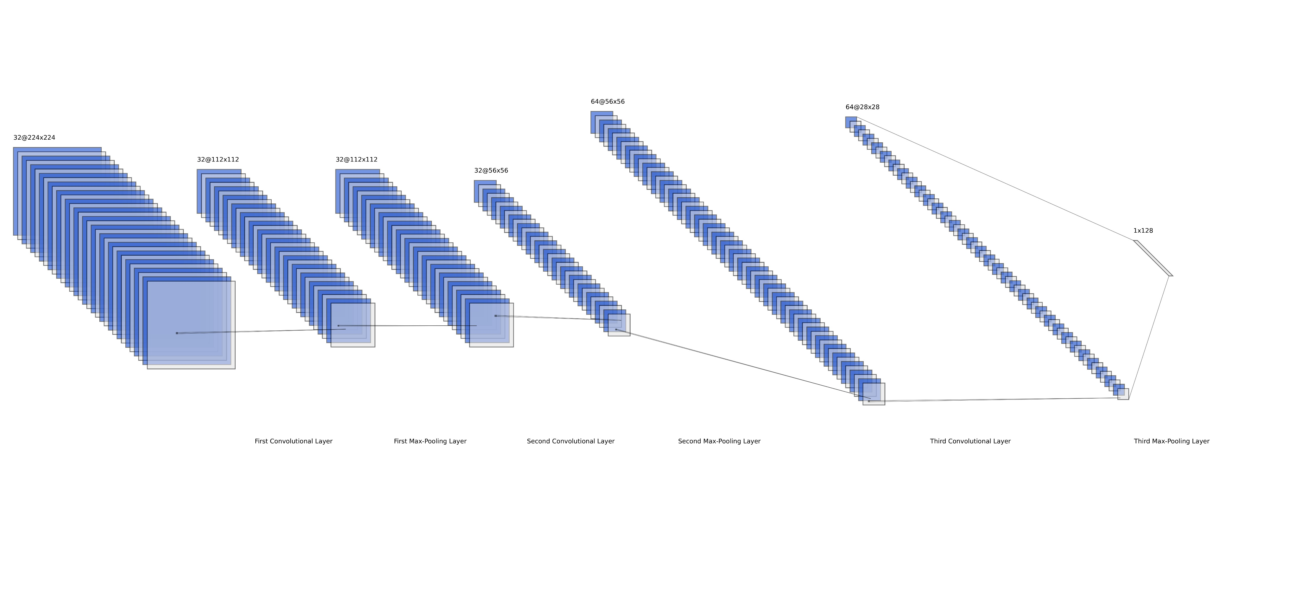



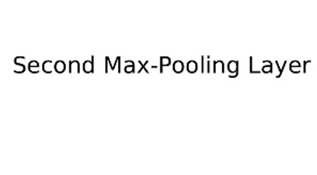
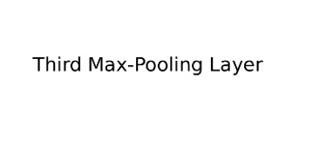
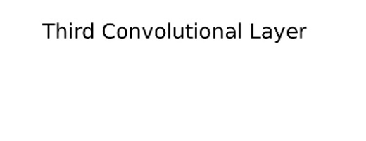
Model Architecture and Development
CNN Model Architecture

Slide 13

CNN Model Architecture
Convolutional Layers: The model consists of three convolutional layers that are responsible for extracting features from the input images. Each layer applies 32 filters (except the last one, which applies 64) to capture patterns such as edges, textures, or more complex shapes within the chest X-ray images.
1
Activation Function: After each convolution operation, the model uses the Rectified Linear Unit (ReLU) activation function. ReLU introduces non-linearity into the model, allowing it to learn more complex relationships in the data.
2
Pooling Layers: Each convolutional block is followed by a max pooling layer with a 2x2 window and a stride of 2. These layers reduce the spatial dimensions of the feature maps, which decreases computation and the number of parameters, helping to prevent overfitting.
3
Fully Connected Layers: Towards the end, the model has two fully connected (dense) layers that perform high-level reasoning by integrating the learned features from the convolutional layers. The output is then mapped to the final prediction.
4
Sigmoid Output: The final layer of the model applies a sigmoid activation function, squashing the output to a range between 0 and 1. This output can be interpreted as the probability of the X-ray showing signs of pneumonia, enabling the model to make binary classifications.
5
Model Architecture: The architecture is specifically designed for binary classification tasks, like distinguishing between normal and pneumonia-affected chest X-ray images.
6

Slide 14

Loss and Optimizer
Loss Function (criterion): nn.BCELoss() calculates Binary Cross-Entropy Loss, suitable for binary classification tasks. It measures the error between the predicted probabilities and the true binary labels.
Optimizer (optimizer): optim.Adam() updates model parameters using an adaptive learning rate method, improving efficiency on problems with sparse gradients. It’s set with a learning rate (lr) of 0.001 to control the adjustment speed of the weights during training.

Slide 15
Model Training
Training Process (train_model function):
The function takes a model, training and validation data loaders, a loss criterion, an optimizer, and an optional number of epochs (default is 5). It executes a training loop where the model is set to train mode, processes batches of images, calculates loss, performs backpropagation, and updates model weights.
Metric Calculation During Training:
Within each epoch, it computes training loss, accuracy, precision, recall, and F1 score by comparing the predicted outcomes with actual labels. These metrics are calculated for both training and validation phases, capturing the model's performance and its generalization capability on unseen data assessed on the validation data.

Slide 16
Model Training
Validation Performance Monitoring:
After training on all batches, the model is evaluated in a separate validation phase without gradient updates (using torch.no_grad() context), ensuring that the model's performance is assessed based on its ability to generalize, rather than memorize the training data.
Logging and Output:
At the end of each epoch, detailed metrics for both training and validation phases are printed, allowing for monitoring the model's learning progression over epochs. This helps in diagnosing training behavior such as overfitting or underfitting.
Evaluation and Confusion Matrix (evaluate_model function):
This function sets the model to evaluation mode and processes a test dataset to predict outcomes. It then calculates a confusion matrix, which is returned as a pandas Data Frame, providing a clear visual of the model’s performance in terms of true positives, true negatives, false positives, and false negatives for binary classification.

Slide 17
Model Training and Validation Performance
Overview:
Training conducted over 5 epochs to refine model performance across key metrics: loss, accuracy, precision, recall, and F1-score.
Performance Highlights:
Initial Training: Began with a loss of 0.2710, with accuracy reaching 89.73% and a validation accuracy peak at 97.22% in the first epoch.
Mid-Training Adjustments: Experienced fluctuations, with a notable dip in validation accuracy to 93.06% in the second epoch, before peaking again at 98.61% in the fourth epoch.
Stabilization: Both training and validation metrics stabilized by the fifth epoch with consistent accuracy and F1-scores around 97.22%.

Slide 18
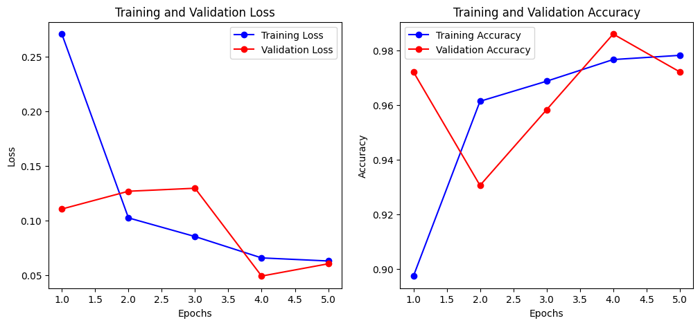
Model Training and Validation Performance
Graphical Analysis: The graphs show a marked decrease in training loss and a peak in training accuracy by the fifth epoch, while validation loss fluctuates and validation accuracy peaks then slightly declines, suggesting potential overfitting.

Slide 19
Final Model Evaluation and Confusion Matrix
Final Metrics:
Model demonstrates high robustness with final training accuracy consistently above 97%, highlighting precise pneumonia detection.
Confusion Matrix Insights:
Confusion matrix for final evaluation shows:
True Positives: 114
True Negatives: 379
False Positives: 120
False Negatives: 11
Summary:
High sensitivity with significant true negatives but room for improvement in reducing false positives.
Performance analysis suggests excellent model effectiveness with recommendations for further precision enhancements.

Slide 20
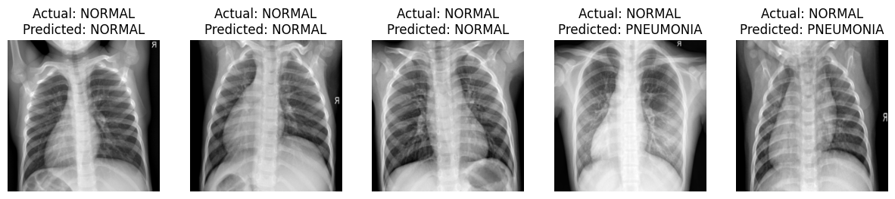
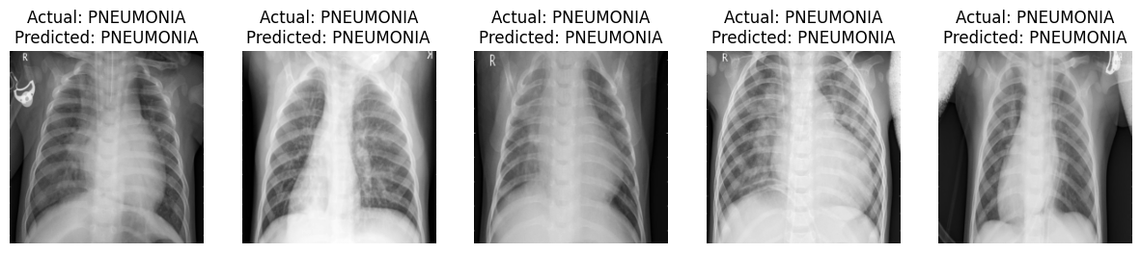
Model Predictions on Test Dataset
Testing Accuracy and Overview: The model achieved a testing accuracy of 79.17% across a diverse set of chest X-ray images. The predictions reflect the model's ability to distinguish between normal and pneumonia-affected lungs.

Slide 21
Discussion
Challenges Faced by the Team:
The team encountered challenges with model overfitting, as evidenced by the fluctuating validation accuracy and loss across the epochs. This was addressed by adjusting hyperparameters and enhancing the validation set to ensure a more robust evaluation of the model's generalizability.
Limitations of the Team’s Approach:
A significant limitation noted was the variability in validation performance, which may indicate inconsistencies in the dataset or insufficient model complexity to capture all the nuances in the data. Efforts to expand and diversify the training data and potentially explore more complex model architectures were considered to overcome these limitations.

Slide 22
Future Work
Improvements:
To improve the model, incorporating regularization techniques or exploring advanced neural network architectures could help mitigate overfitting and enhance generalization.
Potential Applications:
The model's capability in detecting pneumonia from X-rays could be extended to automated diagnostic systems in healthcare settings, and further research could explore its applicability to other medical imaging tasks, such as detecting different types of lung diseases.

Slide 23
Conclusion
Summary of Team Findings:
The team successfully developed a model that shows promise in pneumonia detection with high training accuracy, though challenges with validation consistency highlighted the need for further model optimization and data handling strategies.
Impact on the Field:
Solving this challenge advances medical imaging by providing a potential tool for automated, rapid diagnosis of pneumonia, thereby supporting faster clinical decision-making and broadening the scope for AI applications in healthcare diagnostics.

Slide 24
Thank You

